Slide 1
Warehouse Picking Creation
Warehouse Picking Activity
Delivery Confirmation

Slide 2
The Problem
Warehouse and delivery processes can rely heavily on emails, manual paperwork and people remembering to update others, which can lead to:
Time wasted creating and communicating warehouse pick requests
Information being manually entered or re-entered at different stages
Pick requests being missed, delayed or containing incorrect information
Limited visibility of where an order is within the warehouse process
Difficulty tracking whether goods have been picked, dispatched or delivered
Delivery confirmation not being consistently captured
Staff spending time chasing colleagues for updates
Increased risk of human error and inconsistent processes
The Solution
A Microsoft 365 automated warehouse workflow that manages the process from pick creation through warehouse activity to delivery confirmation.
Using Microsoft Forms, Outlook, Power Automate and SharePoint Lists, information is captured in a structured way and passed through each stage of the process.
This provides a central record of the order and its progress, while automation handles appropriate notifications and updates as the order moves from:
Pick Request → Warehouse Activity → Dispatch → Delivery Confirmation

Slide 3
Key Benefits
⏱ Saves Time
Reduces manual administration, repetitive data entry and internal chasing.
✓ Reduces Human Error
Structured data capture and automated processing reduce reliance on information being manually copied between systems or emails.
👁 Improves Visibility
Provides a central SharePoint record so the business can see the status and progress of warehouse activity.
📦 Creates a Consistent Process
Every warehouse request follows the same defined workflow rather than depending on individual working practices.
🔔 Improves Communication
Automated notifications keep the appropriate people informed as the order progresses.
🚚 Closes the Loop on Delivery
Delivery confirmation becomes part of the process rather than an isolated final step.
📊 Creates an Audit Trail
Key warehouse and delivery activity can be recorded against the transaction, providing greater traceability.
💷 Makes Better Use of Microsoft 365
For businesses already using Microsoft 365, the solution builds on familiar tools such as Outlook, Forms, SharePoint and Power Automate rather than introducing another standalone workflow application.

Slide 4

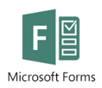


Workflow diagram
Pick request email arrives
Warehouse team automatically notified of request
A new record is automatically generated on SharePoint list
Warehouse Manager assigns Picker
Picker carries out task and updates MS Form for submission
SharePoint list updates with completion status or advises of any issues
Delivery Drive assigned, completes MS Form stating if delivery was successful or not
SharePoint list automatically updates with completed/failed status plus any relevant notes added by Driver

Slide 5
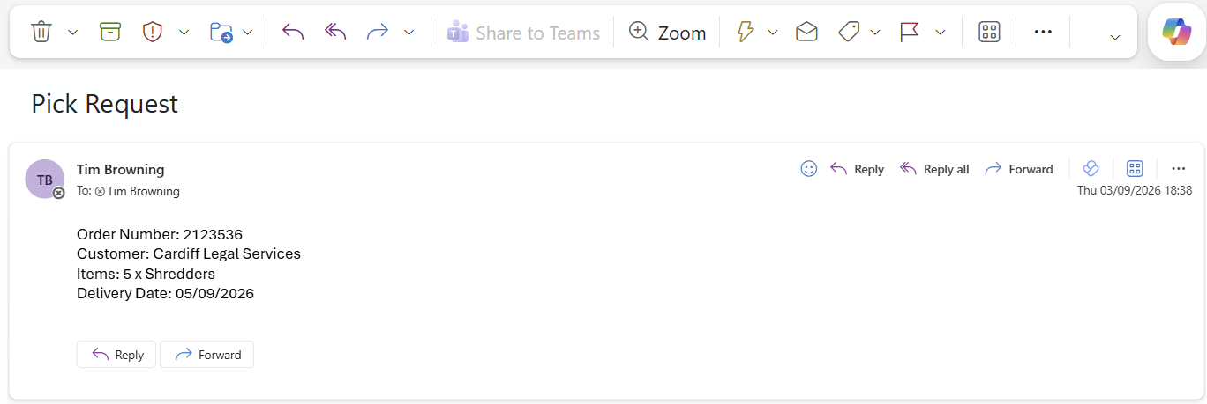
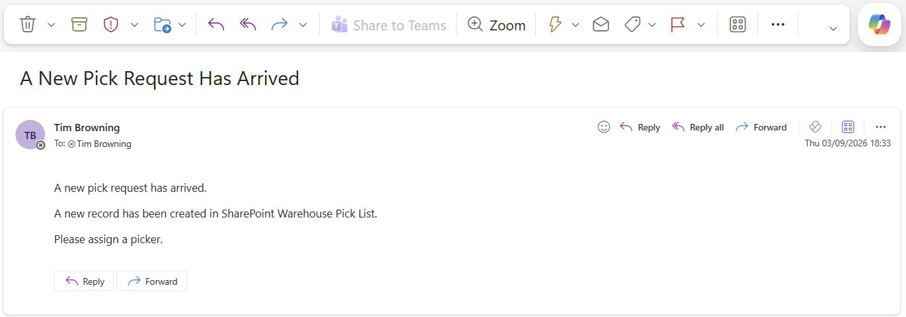
Pick Request / Creation
1 – Pick request email received
2 – generate automated notification to warehouse team
3 – initiates new record on SP List

Slide 6
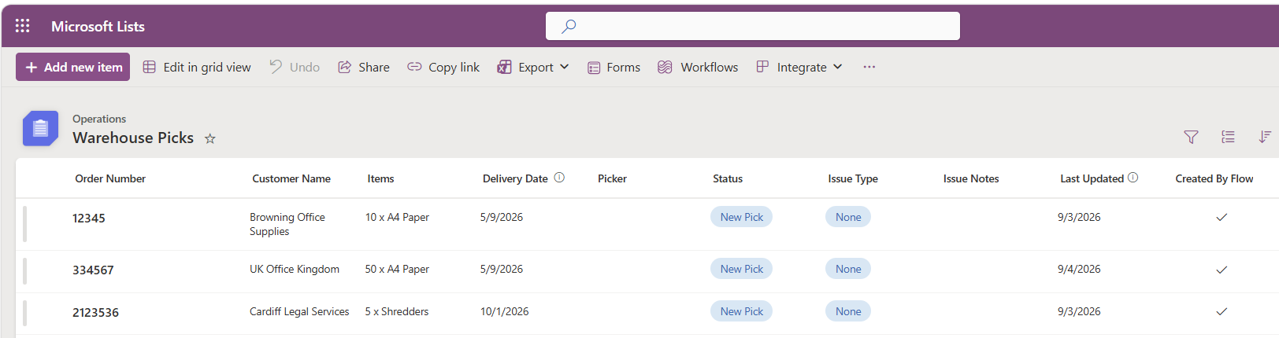
Pick Request / Creation

Slide 7
Warehouse Picking Creation
Warehouse Picking Activity
Delivery Confirmation

Slide 8
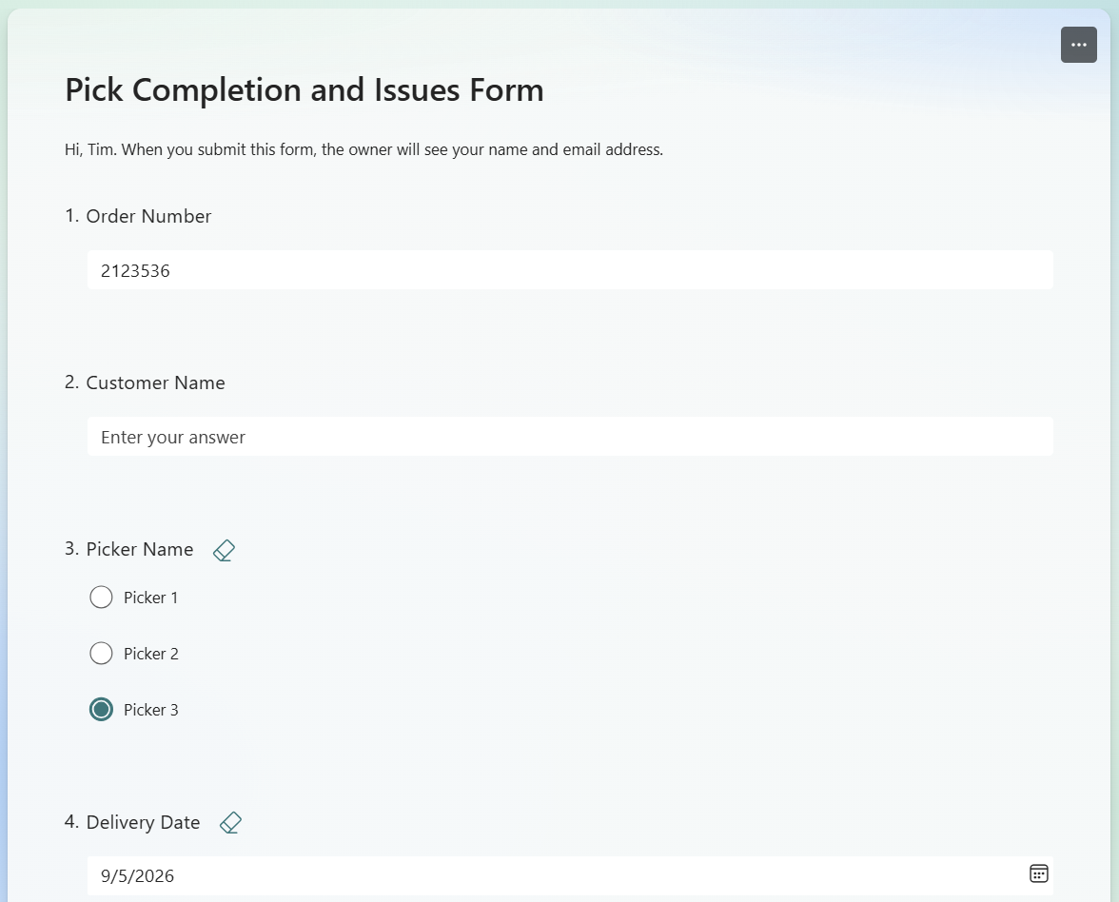
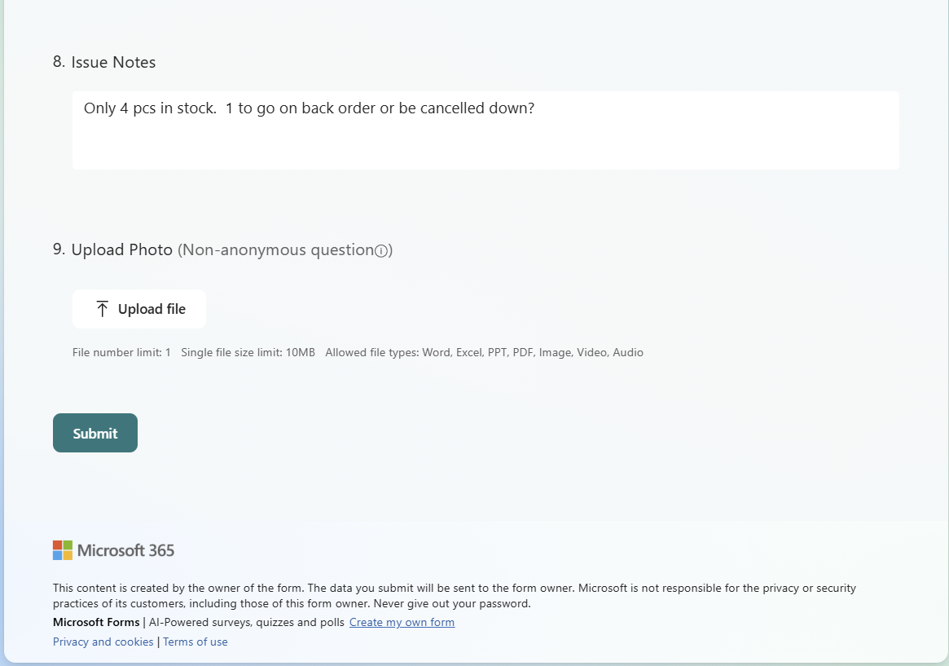
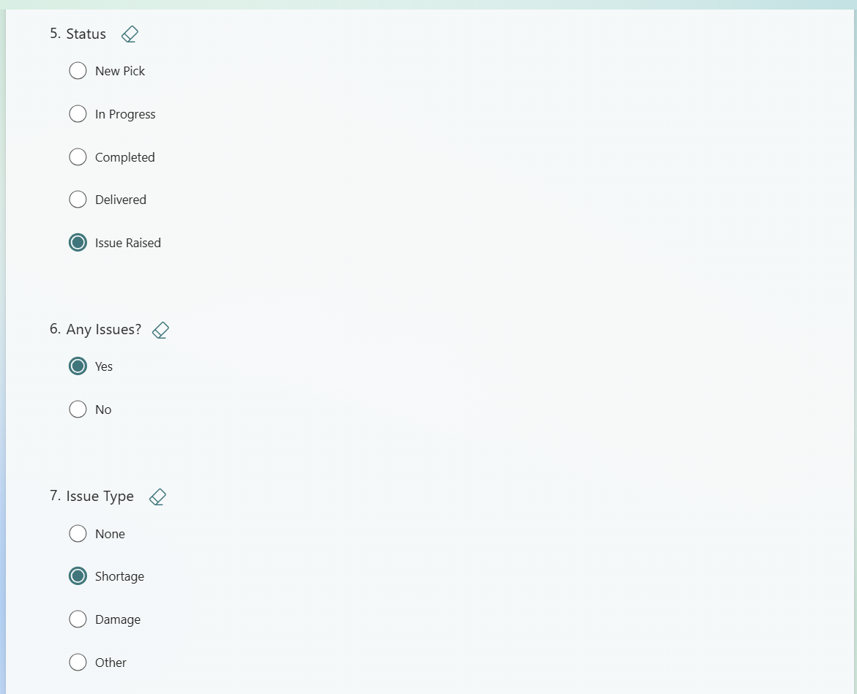
Warehouse Pick Activity

Slide 9
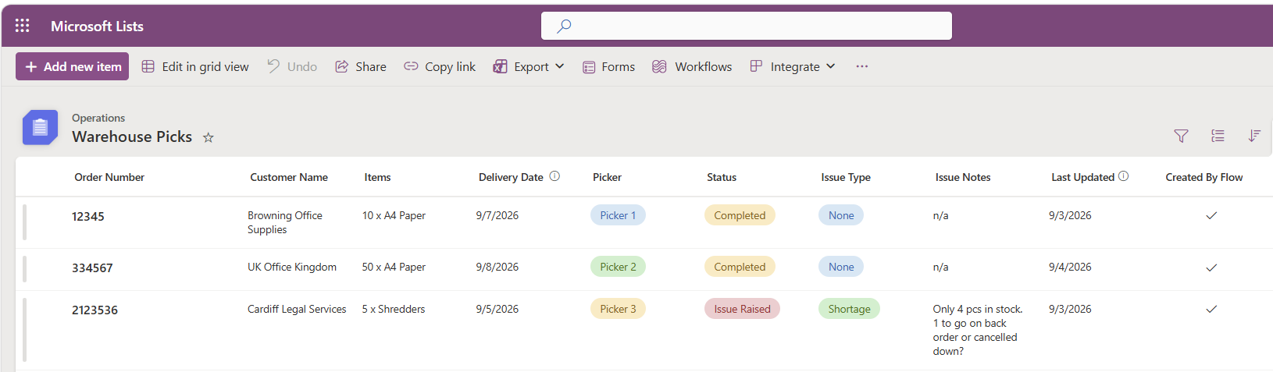
Warehouse Pick Activity

Slide 10
Warehouse Picking Creation
Warehouse Picking Activity
Delivery Confirmation

Slide 11
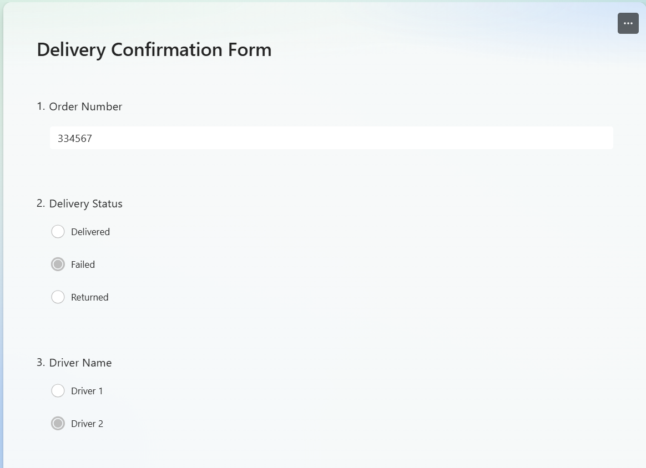
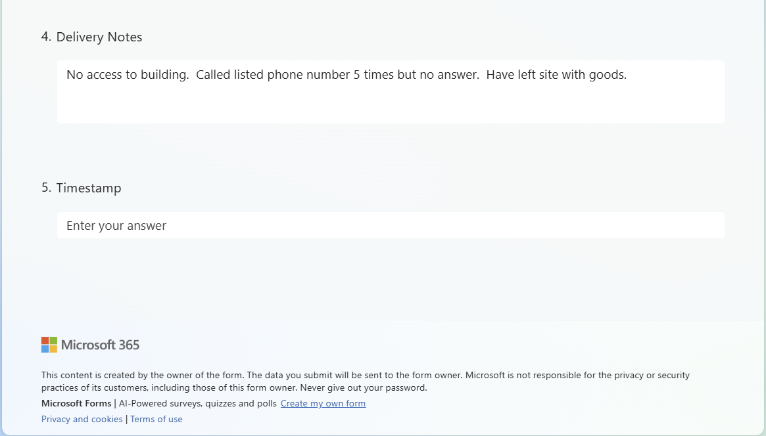
Delivery Confirmation Form

Slide 12
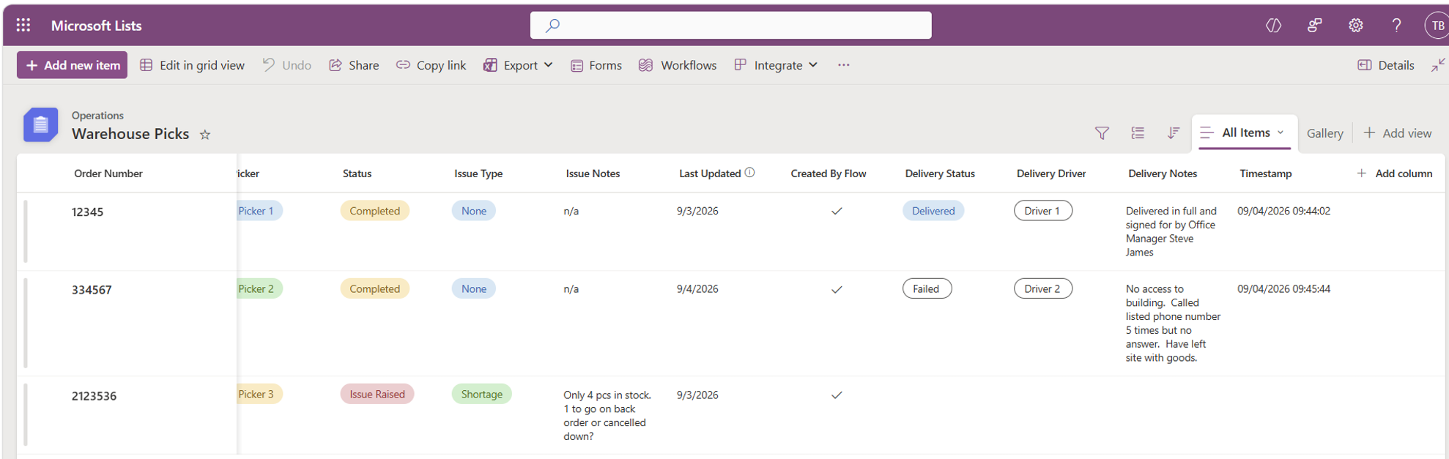
Delivery Confirmation List

Slide 13
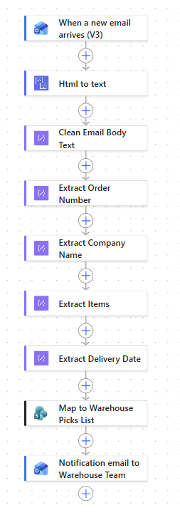

Workflow 1 – Pick Creation

Slide 14
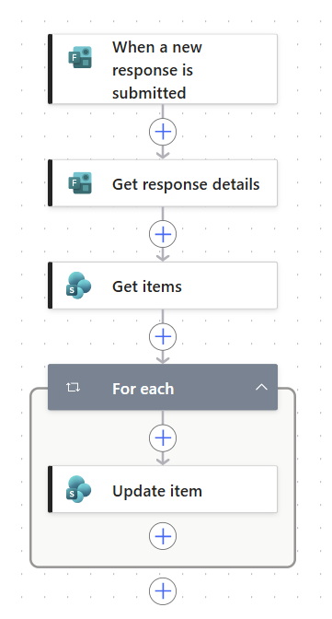

Workflow 2 – Warehouse Activity

Slide 15
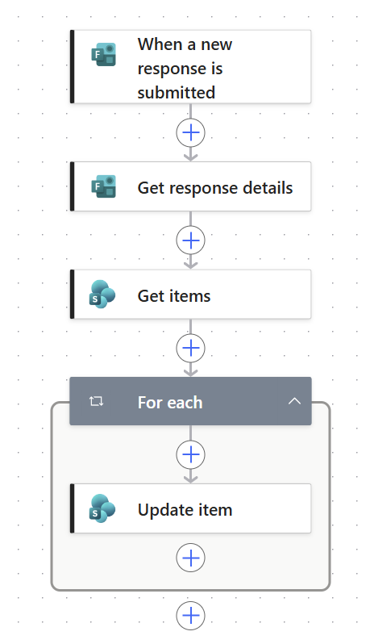

Workflow 3 – Delivery Confirmation

