Slide 1
Sales Enquiry Automation

Slide 2
The Problem
Many customer enquiries are still managed manually through shared inboxes, individual emails and spreadsheets.
This often leads to:
Enquiries being missed or overlooked
Slow response times to customers
Manual forwarding between departments
No clear ownership of enquiries
Inconsistent customer experience
Sales opportunities falling through the cracks
Limited visibility of enquiry volumes and activity
Time wasted on administration rather than selling
The Solution
A Microsoft 365 powered Customer Enquiry Management System that automatically:
✅ Captures enquiries from a shared mailbox
✅ Creates a central enquiry record
✅ Generates a unique enquiry reference
✅ Categorises enquiries by product area:
Furniture
Print
Technology
Office Supplies
✅ Sends an immediate customer acknowledgement
✅ Assigns enquiries to the appropriate salesperson
✅ Notifies the assigned team member automatically
✅ Creates a searchable audit trail for every enquiry

Slide 3
Key Benefits
Faster Response Times
Customers receive an acknowledgement immediately and enquiries are routed without delay.
No Missed Opportunities
Every enquiry is captured, tracked and assigned automatically.
Reduced Administration
Eliminates manual logging, forwarding and triage of enquiries.
Increased Accountability
Every enquiry has a clear owner and status.
Improved Customer Experience
Customers receive a professional, consistent response every time.
Better Visibility
Management can see enquiry volumes, categories and ownership in one place.
Scalable Process
Handles increasing enquiry volumes without increasing administration effort.
Typical Results
✔ Faster customer response times
✔ Reduced manual processing
✔ Better sales team productivity
✔ Improved visibility of sales opportunities
✔ Increased consistency across the business

Slide 4




Workflow and Tools Used
Captures enquiries from a shared mailbox
Creates a central enquiry record on Sharepoint List
Generates a unique enquiry reference
Sends an immediate customer acknowledgement
Assigns enquiry to appropriate salesperson
Categorises enquiries by product area: Furniture; Print; Tech; Office Supplies
Notifies the assigned team member automatically
Creates a searchable audit trail for every enquiry

Slide 5
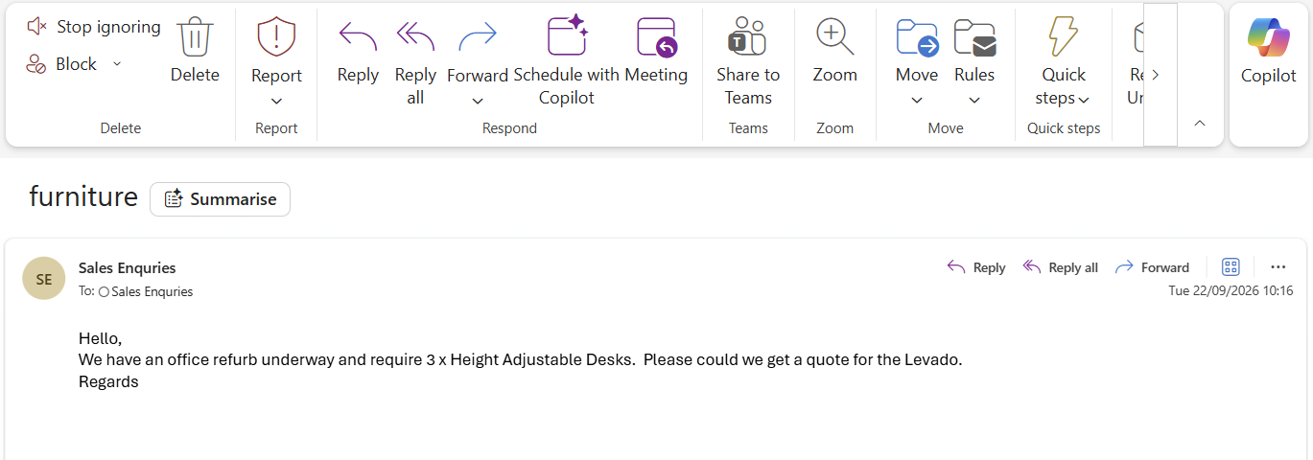
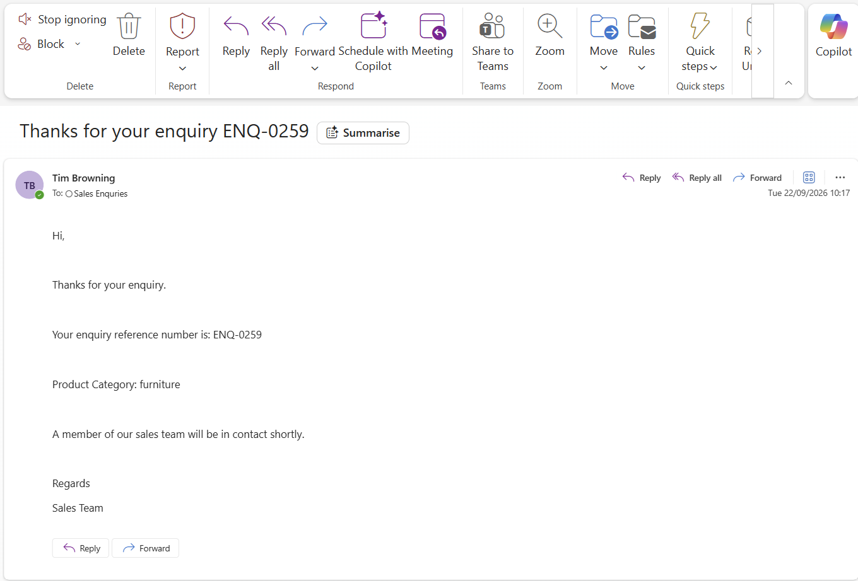

Slide 6
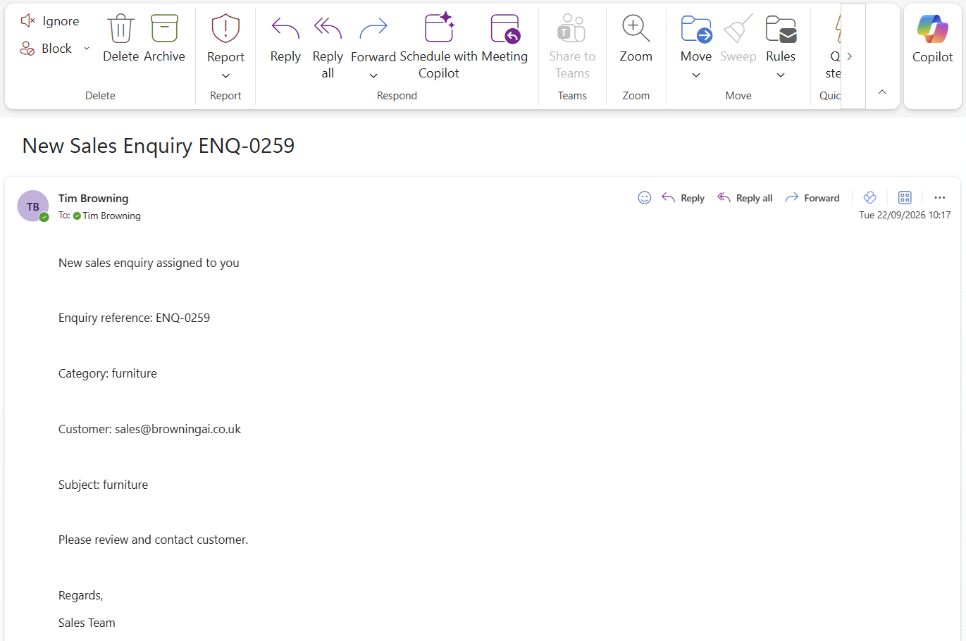

Slide 7
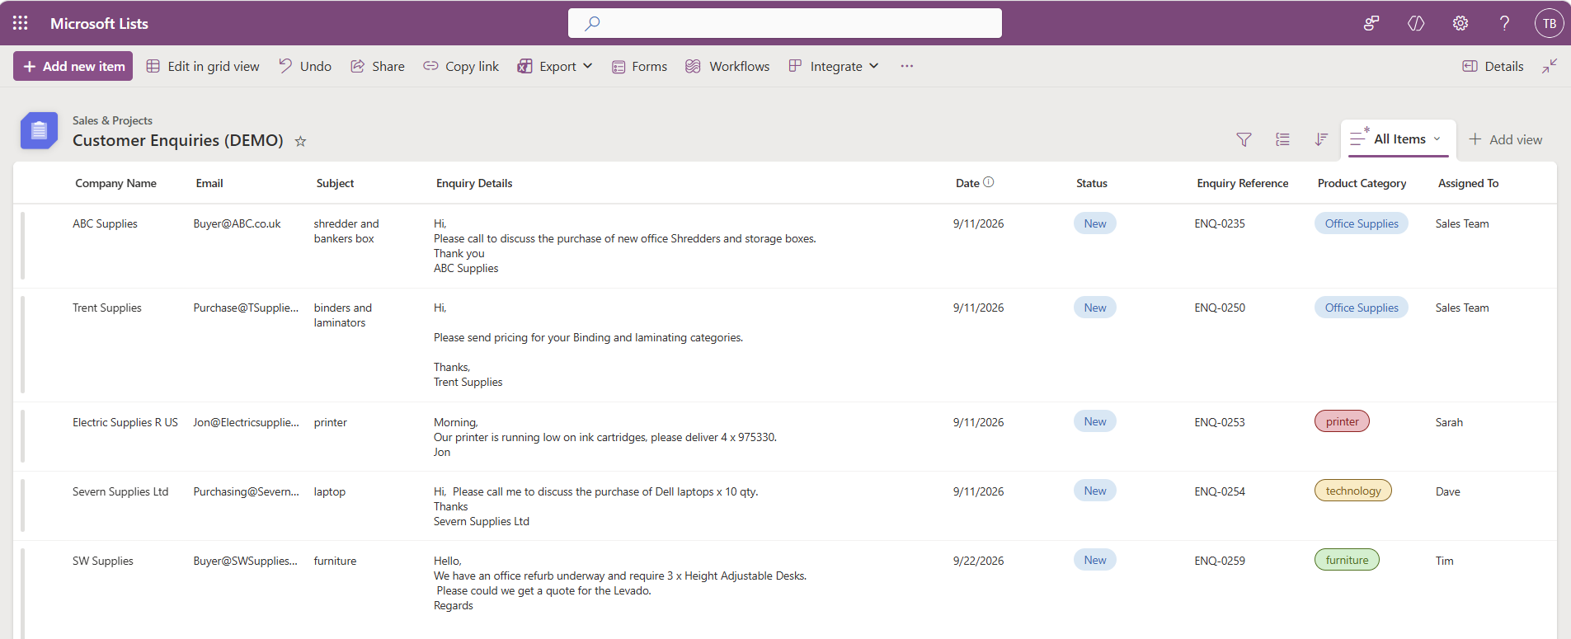

Slide 8
