Slide 1
Purchase Approval Automation
From Purchase Request to Approval, Automatically

Slide 2
The Problem
Purchase requests handled through emails, spreadsheets or verbal approvals can be difficult to track.
Different purchase values require different levels of authorisation.
Requests can get delayed when it is unclear who needs to approve next.
Limited visibility makes it harder to maintain a clear audit trail.
Requesters may need to chase managers or Finance for updates.
The Solution
A structured automated purchase approval process:
Employee submits a simple digital purchase request.
The request is automatically recorded in a central tracking system.
Approval is routed according to purchase value:
  Up to £1,000: Manager approval
  £1,000 to £5,000: Manager + Finance approval
  Over £5,000: Manager + Finance + Director approval
Each stage and decision is recorded centrally.
The requester receives automatic updates throughout the approval process.
Rejected requests are also captured, creating a clear record of the decision.

Slide 3
Key Benefits
Saves time by removing manual chasing and forwarding.
Reduces human error through consistent automated routing.
Improves financial control by ensuring the correct approval levels are followed.
Creates a clear audit trail of requests and approval decisions.
Provides greater visibility of where every request is in the process.
Keeps employees informed with automatic status notifications.
Standardises the process across the business.
Reduces administration for managers and Finance teams.

Slide 4





Purchase request submitted via MS Form
Request is automatically recorded on SharePoint tracking list
All requests are sent to the Manager for approval
Value check, flow determines the next approval level
Up to £1,000 Manager approval completes process
£1,000 - £5,000 requires Finance additional approval
Over £5,000 requires Directors approval to complete the process
Approval Status is updated at each decision stage on SharePoint list
Requester is updated at each stage of approval
Final approval/rejection is recorded and requester updated

Slide 5
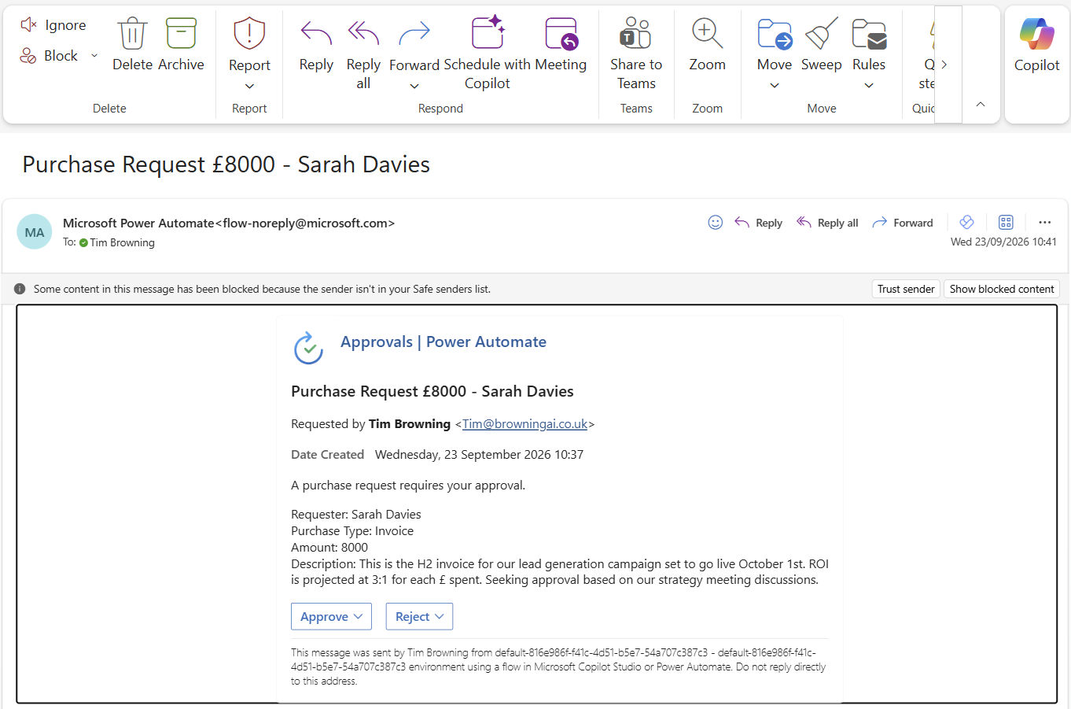

Slide 6
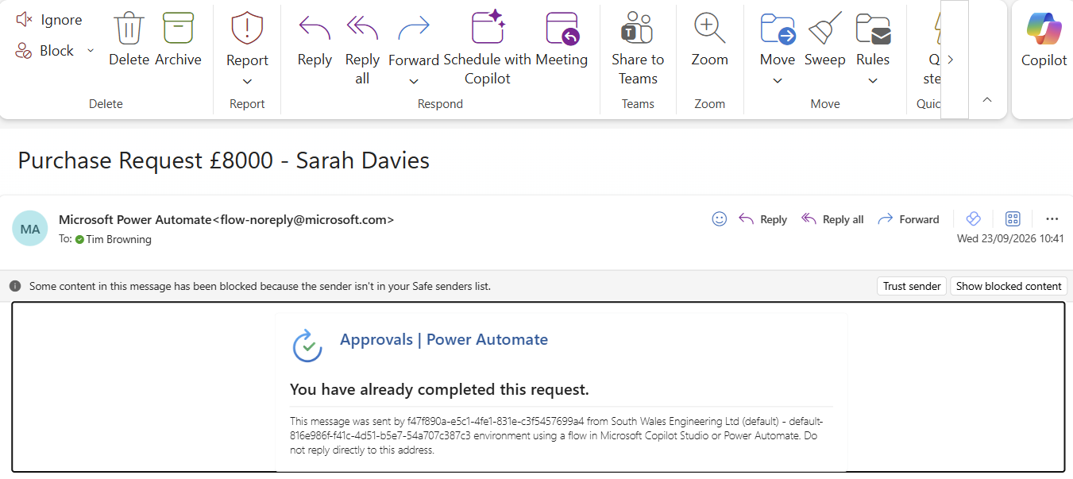

Slide 7
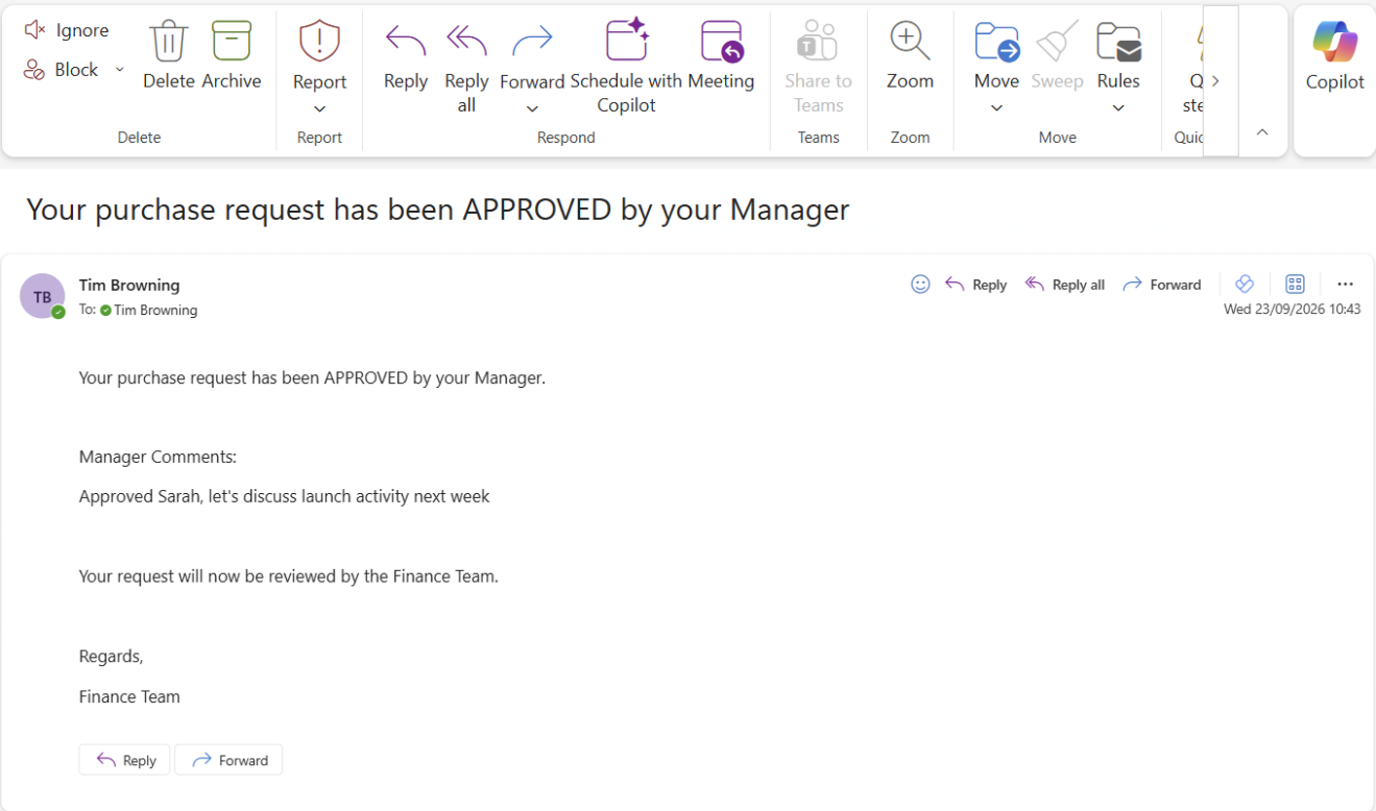

Slide 8
