Slide 1
Customer Service Management Automation
Turn incoming customer emails into a structured, automated customer service process

Slide 2
The Problem
Customer service enquiries arriving by email often require manual reading, categorising and forwarding to the correct department.
This can lead to:
Time spent manually processing routine enquiries
Emails being sent to the wrong team
Enquiries being missed or delayed
Inconsistent categorisation
Limited visibility of enquiry volumes and types
Difficulty tracking enquiries from receipt through to resolution
The Solution
A Microsoft 365 customer service automation that automatically processes incoming customer emails.
Using Outlook, Power Automate and SharePoint, the solution:
Customer Email Received
↓
Power Automate reads the enquiry
↓
Product category identified
↓
Correct department assigned
↓
Appropriate email/contact assigned
↓
Enquiry recorded in SharePoint
For example, enquiries can automatically be routed to Print Support, Logistics Team or Customer Service, creating a consistent process for every incoming request.

Slide 3
Key Benefits
⏱ Saves Time
Reduces the manual administration involved in reading, categorising, recording and routing enquiries.
✓ Reduces Human Error
Creates a consistent process rather than relying on someone to manually decide where each enquiry should go.
⚡ Faster Routing
Enquiries can be directed to the appropriate department as part of the automated process.
👁 Better Visibility
Creates a central SharePoint record of customer enquiries rather than relying solely on individual emails.
📊 Better Management Information
Structured data such as product category and department provides a foundation for reporting on the types of enquiries being received.
📈 Scalable Process
Provides a repeatable process that can support increasing enquiry volumes without adding the same level of manual administration.

Slide 4



Workflow and Tools Used
Customer sends a service enquiry by email
The enquiry is categorised based on the product or issue
Correct department is identified; Print Support; Logistics…etc
Email is detected and enquiry details are extracted + customer received immediate acknowledgement email
SharePoint record is created on the Customer Service list
Appropriate Email assigned by department
Ready for action with comprehensive audit trail

Slide 5
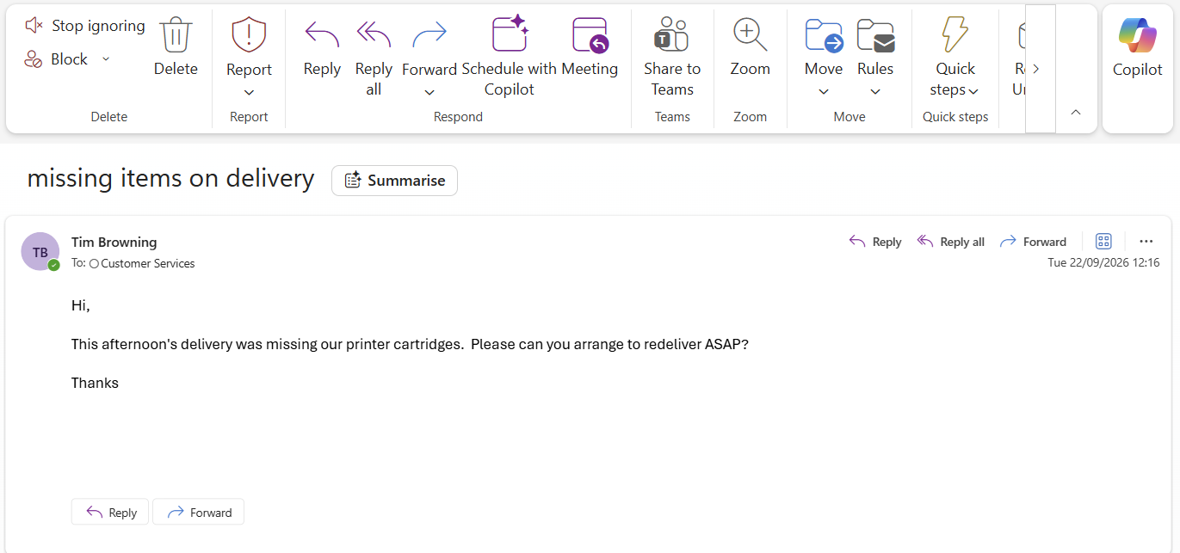
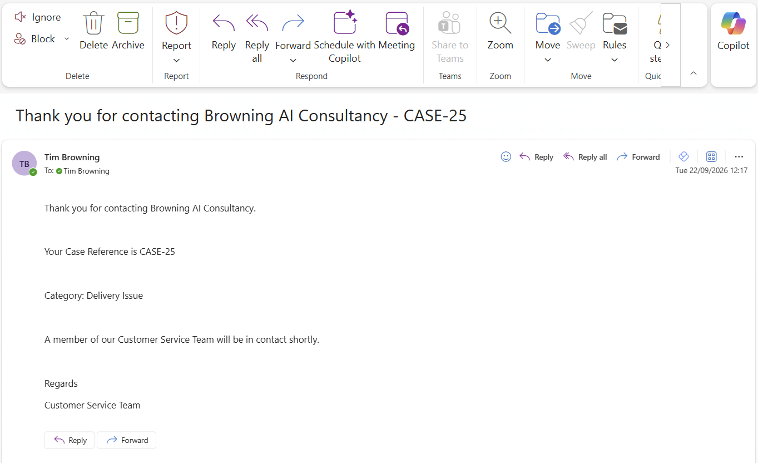

Slide 6
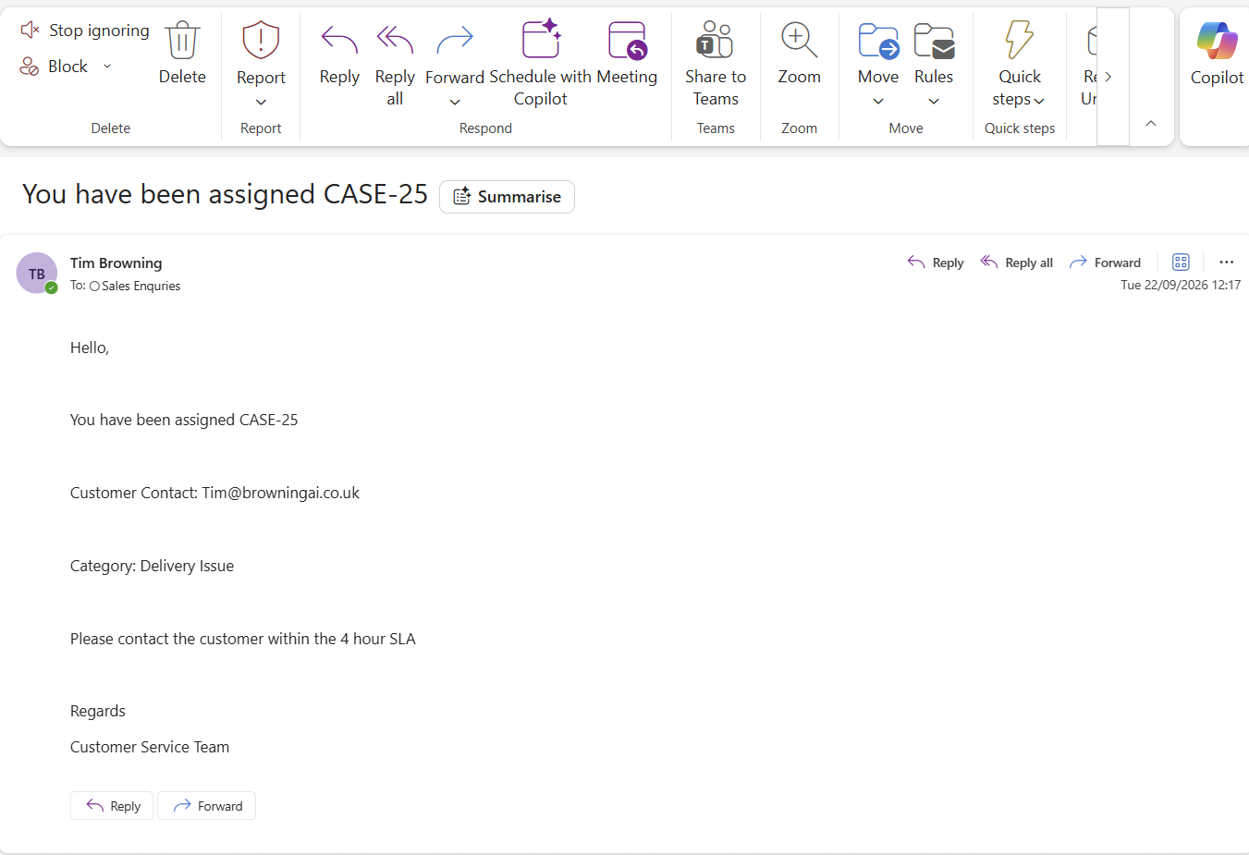

Slide 7
